Slide 1
Software Quality assurance
Program java
-MELLOUKI Younes
-ZAZA Zakaria

Slide 2
Description of the program
SDLC models classifier

Slide 3
Part1: Interaction
Part2: Analyze
Part1: Result

Slide 4
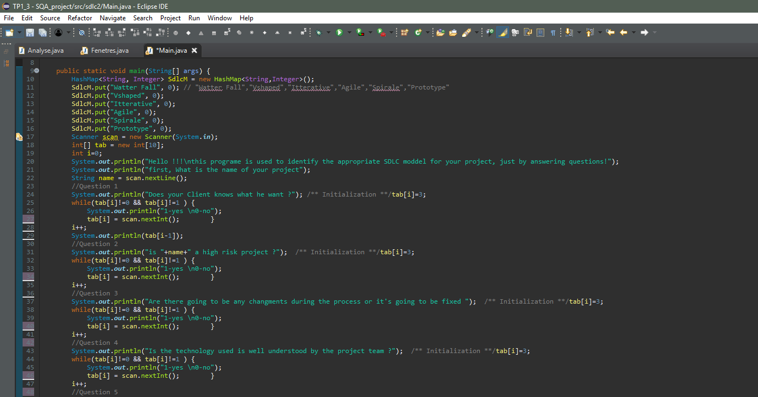

Slide 5
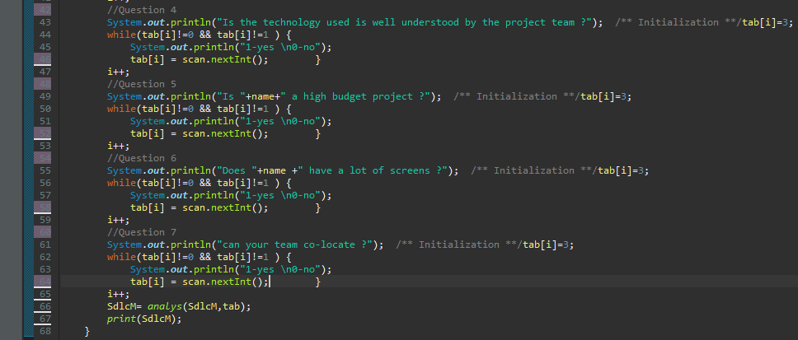

Slide 6
Part1: Interaction
Part2: Analyze
Part1: Result

Slide 7
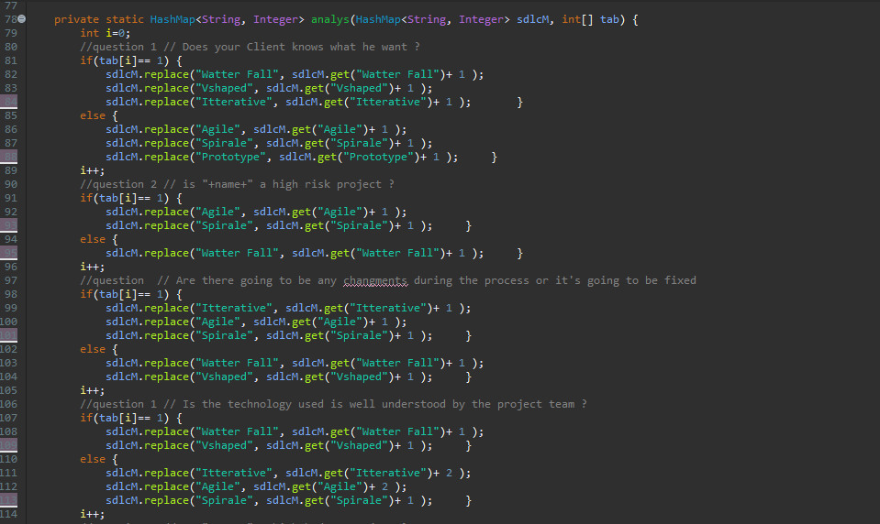

Slide 8
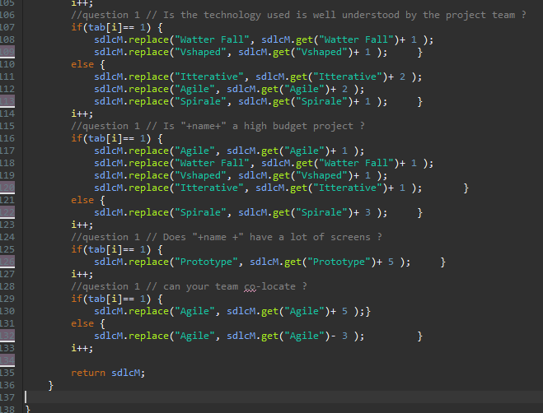

Slide 9
Part1: Interaction
Part2: Analyze
Part1: Result

Slide 10
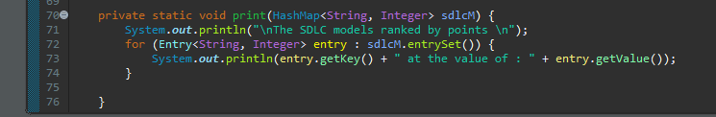

Slide 11
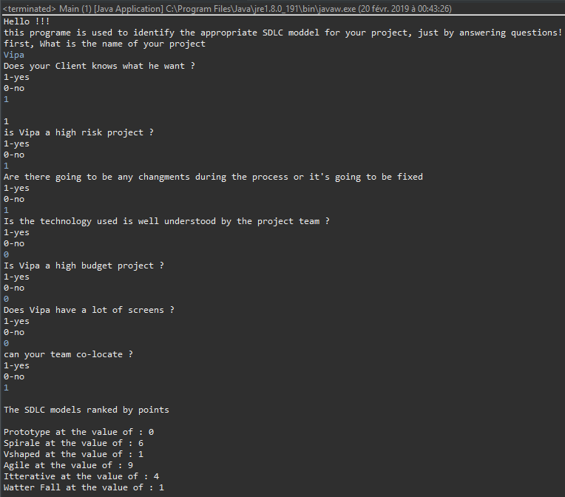

Slide 12


